Slide 1


MSc in Microbiome in Health and Disease
M2: Metagenomics workshop
(https://github.com/FrederickClasen/KCL_MSc_2023)
Frederick Clasen
(frederick.1.clasen@kcl.ac.uk)

Slide 2
Overview of the week
# | Day | Lecture | Workshop
1 | Monday | Introduction // Goals of the week // Introduction to using HPC environments | Log into CREATE
2 | Tuesday | Recap of to CONDA and metaphlan // explanation of the environment | Setting up conda environment // Install Metaphlan Run metaphlan single sample // submit batch job to the cluster
3 | Wednesday |  | Data analysis part 1
4 | Thursday |  | Data analysis part 2
5 | Friday |  | Data analysis part 3 – you code and we assist
Contact information
Name | Email
Frederick Clasen | frederick.1.clasen@kcl.ac.uk
Yi Jin | yi.1.jin@kcl.ac.uk
Haizhuang Cai | haizhuang.cai@kcl.ac.uk
Ali Kaynar | ali.kaynar@kcl.ac.uk
Ricardo de Oliveira Costeira | ricardo.de_oliveira_costeira@kcl.ac.uk
Elle Hill | elle.hill@kcl.ac.uk

Slide 3
Housekeeping and objectives of the week
This is longest and most intense workshop of the course that brings together an array of computational tools to be able to process, analyze and interpret metagenomics data
We provide EVERYTHING for you so even if you get lost, do not worry all the output and results is already there
Therefore, use the time to UNDERSTAND what you are doing and to AKS QUESTIONS about the details of what you are doing
For the parts that happens on the cluster: please do not continue ahead with the next steps before the entire group does so
We do expect that by now you can navigate yourself in Linux and will not always provide all the commands to, for example, change into specific directories etc
Objectives:
Familiarize yourself with using a high-performance cluster (HPC) computing environment in a Linux environment
Use basic scripting to run algorithms on the CREATE server
Work through the R code provided to analyze metagenomics data
Use the results generated to interpret the underlying biology of the dataset analyzed

Slide 4
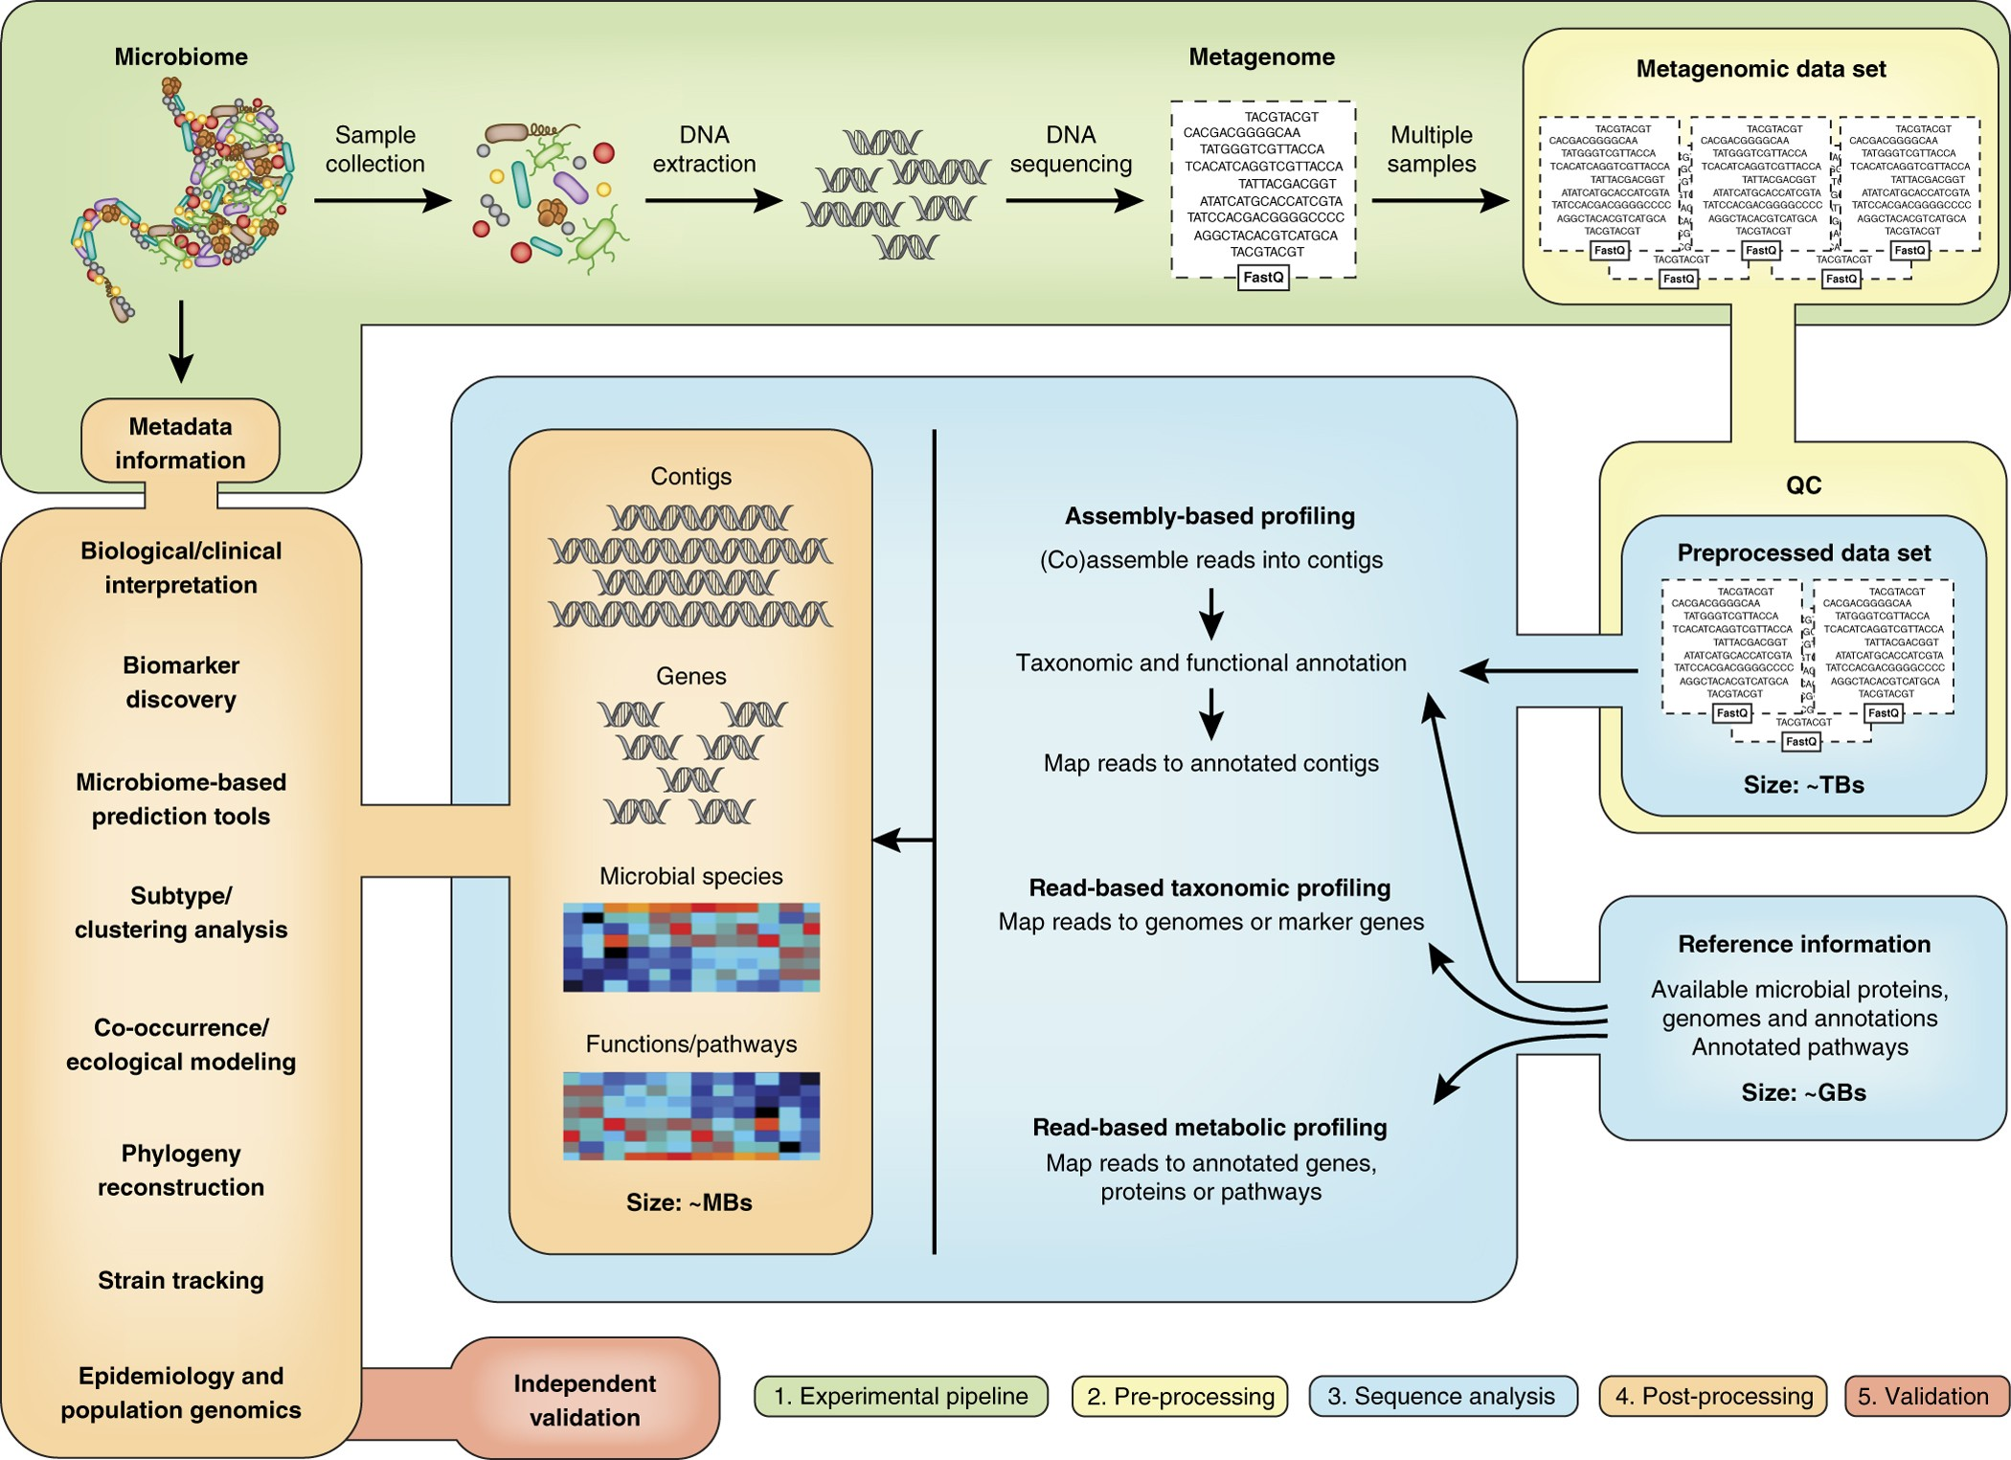
Metagenomics overview
Different methodologies for each step with advantages and disadvantages
Quince et a., Nature Biotechnology (2017)
Notes:
Introduction to Linux
Guidelines on the overview of the course
Interpretation of the data
Output of this used for R course

Slide 5
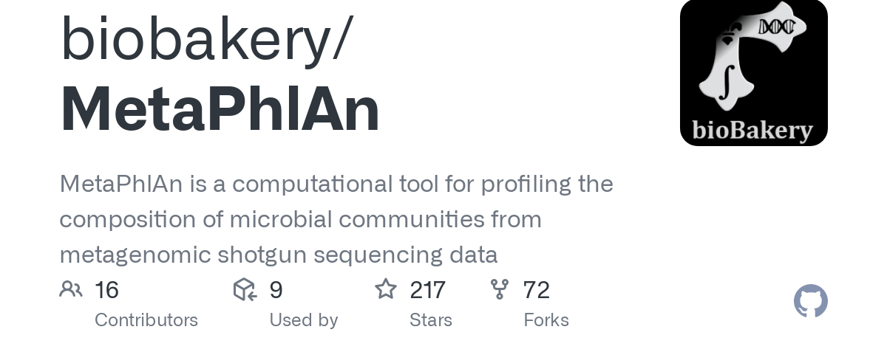

Metagenomics overview
Different methodologies for each step with advantages and disadvantages
Sequence analysis
Map reads onto marker genes of metagenomic species to calculate relative abundance of individual species
One of many ways to go from reads --> species
Abundance table
 | Sample1 | Sample2 | Sample3 | Samplen
Species 1 | 10 | 5 | 30 | ..
Species 2 | 20 | 3 | 10 | ..
Speciesn | … | … | .. | ..
Post processing
Identify patterns and associations that can lead to relevant biological or clinical conclusions
Quince et a., Nature Biotechnology (2017)
Notes:
Introduction to Linux
Guidelines on the overview of the course
Interpretation of the data
Output of this used for R course

Slide 6
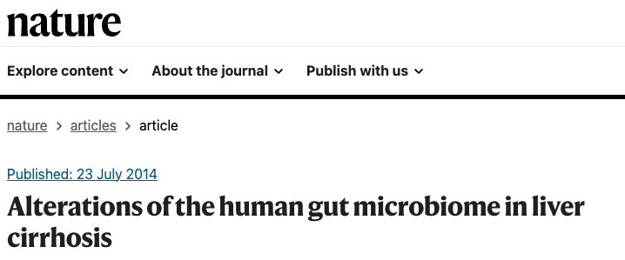

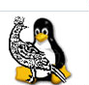
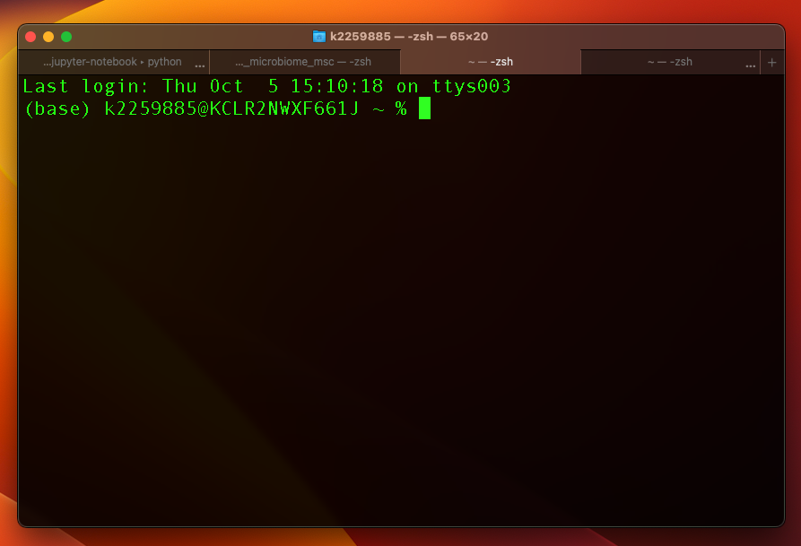
Workshop tools
Dataset
Tools
Please read the publication here:
https://www.nature.com/articles/nature13568
All the materials are on GitHub:
Notes:
Introduction to Linux
Guidelines on the overview of the course
Interpretation of the data
Output of this used for R course

Slide 7
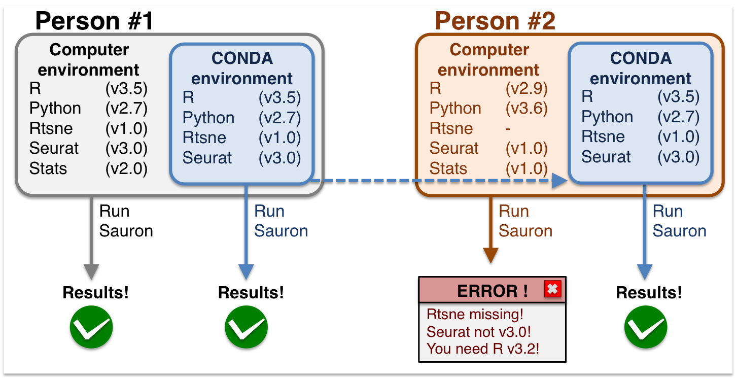
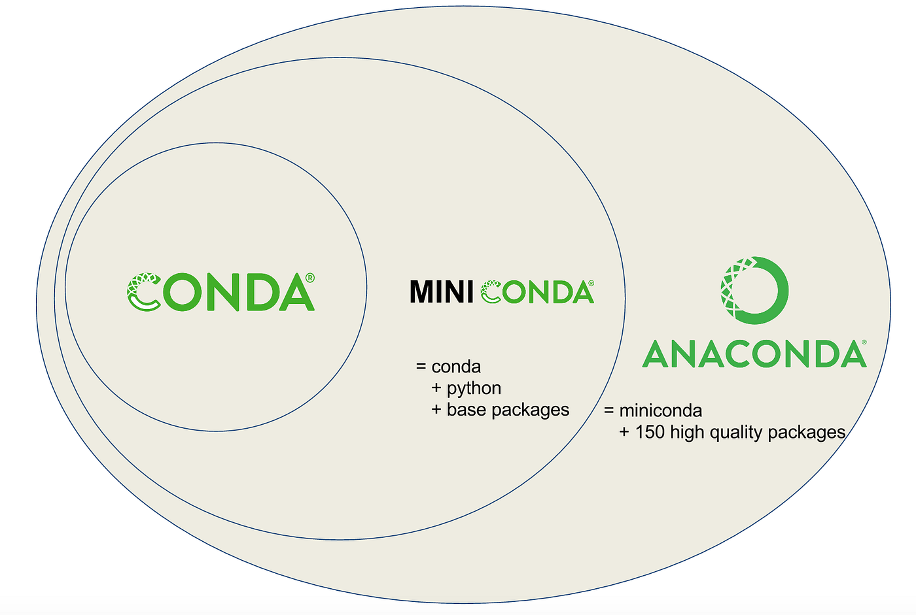
Using virtual environments
A virtual environment is a tool that helps to keep dependencies required by different projects separate by creating an isolated virtual environment for them.
Anaconda is a distribution of the Python and R programming languages for scientific computing, that aims to simplify package management and deployment. The distribution includes data-science packages suitable for Windows, Linux, and macOS
Notes:
Introduction to Linux
Guidelines on the overview of the course
Interpretation of the data
Output of this used for R course

Slide 8


Using a scheduler
Queues incoming jobs and tasks, allocates resources, dispatches nodes and monitors the status of jobs, tasks, and nodes
#!/bin/bash -l
#SBATCH --account clasenf
#SBATCH --partition=core
#SBATCH --ntasks=10
#SBATCH --time=2-00:00:00
#SBATCH --job-name=local-compress
#SBATCH --mail-user=frederick.1.clasen@kcl.ac.uk
#SBATCH --mail-type=ALL
tar -zcvf meteor_ref.tar.gz /proj/uppstore2019028/projects/metagenome/meteor_ref
Commands that tell the scheduler what to do, for example, how many resources to use etc
Jobs/pipelines/commands to run
Notes:
Introduction to Linux
Guidelines on the overview of the course
Interpretation of the data
Output of this used for R course

Slide 9

Pipeline overview
Dataset and setup
Analysis
Interpretation
Dataset (https://www.nature.com/articles/nature13568) on shared location on CREATE that everyone can access
Metaphlan database in shared directory on CREATE
Symbolic links to their own directory
Github repo with the code necessary to run all the steps
A single sample to view output
Entire dataset with batch submission with SLURM (all scripts available)
On local machine – not on CREATE
Output from metaphlan will be available on github
Simple comparative analysis
Notes:
Introduction to Linux
Guidelines on the overview of the course
Interpretation of the data
Output of this used for R course

Slide 10
How to write the report
Introduction
Always starts with the broader picture
1-2 paragraphs on metagenomics and/or liver cirrhosis
1-2 paragraphs on insights of specific studies of the microbiome in liver disease
1 paragraph on what you will do in this study
”In this report/study I will analyze …. to study the impact of microbiome on liver disease in ….. “
Methods
Try and gather as much from original paper under a heading “Sample data” and summarize in 1 paragraph
Then describe what you did → metaphlan, downstream analysis
You can attach scripts as appendices
Results
Clear subheadings. Result 1 … Result 2 …. Result n
For example: “Metagenomics reveals depletion in microbiome diversity in liver disease patients”
Figures and description of what you see in the data
Discussion
Put results in broader context of literature and THINK critical about your data.
This is an MSc course!!!
Introduction
Methods
Results
Discussion

Slide 11
Type of questions you should be able to answer
How does the microbiome differ in liver cirrhosis and healthy control individuals based on diversity analysis?
Describe the main taxonomical differences between liver cirrhosis and healthy controls
How does microbiome species changes correlate with clinical metadata of liver cirrhosis patients?
How does your results overlap with the results presented in the original publication? If it does not, describe the reasons why this might be the case.
Notes:
Introduction to Linux
Guidelines on the overview of the course
Interpretation of the data
Output of this used for R course

Slide 12
Notes:
Introduction to Linux
Guidelines on the overview of the course
Interpretation of the data
Output of this used for R course

Slide 13
MSc in Microbiome in Health and Disease
M2: Metagenomics workshop – recap day1-2
(https://github.com/FrederickClasen/KCL_MSc_2023)
Frederick Clasen
(frederick.1.clasen@kcl.ac.uk)

Slide 14
Notes:
Introduction to Linux
Guidelines on the overview of the course
Interpretation of the data
Output of this used for R course

Slide 15
Pipeline overview
Dataset and setup
Analysis
Interpretation
Dataset (https://www.nature.com/articles/nature13568) on shared location on CREATE that everyone can access
Metaphlan database in shared directory on CREATE
Symbolic links to their own directory
Github repo with the code necessary to run all the steps
A single sample to view output
Entire dataset with batch submission with SLURM (all scripts available)
On local machine – not on CREATE
Output from metaphlan will be available on github
Simple comparative analysis
Notes:
Introduction to Linux
Guidelines on the overview of the course
Interpretation of the data
Output of this used for R course

Slide 16
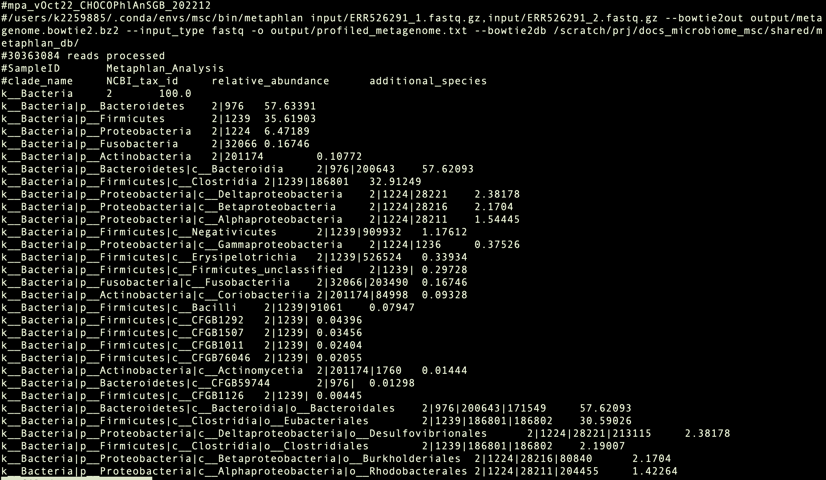
Metaphlan output
Notes:
Introduction to Linux
Guidelines on the overview of the course
Interpretation of the data
Output of this used for R course

Slide 17
How to write the report
Objective of the report:
Re-analyze the metagenomics data from Qin et al to explore how the gut microbiome changes in liver disease patients
It should be written as a short research report following the same structure as a research article
Generate at least five figures that show how the microbiome changes in liver disease patients (diversity, significant species changing etc.) and discuss these results in the context of the literature
https://www.nature.com/articles/s41579-023-00904-3

Slide 18
How to write the report
Introduction
Always starts with the broader picture
1-2 paragraphs on metagenomics and/or liver cirrhosis
1-2 paragraphs on insights of specific studies of the microbiome in liver disease
1 paragraph on what you will do in this study
”In this report/study I will analyze …. to study the impact of microbiome on liver disease in ….. “
Methods
Try and gather as much from original paper under a heading “Sample data” and summarize in 1 paragraph
Then describe what you did → metaphlan, downstream analysis
You can attach scripts as appendices
Results
Clear subheadings. Result 1 … Result 2 …. Result n
For example: “Metagenomics reveals depletion in microbiome diversity in liver disease patients”
Figures and description of what you see in the data
Discussion
Put results in broader context of literature and THINK critical about your data.
Introduction
Methods
Results
Discussion

